Slide 1
CRAFT VERSE
Name:-MADHUSMITA SAHOO
Reg No:- 2305260011

Slide 2
aBSTRACT
Craft Verse is an e-commerce platform designed to provide a seamless shopping experience for craft enthusiasts, offering a wide range of handcrafted products. The website is developed using Spring Boot, ensuring a robust, scalable, and efficient backend for managing products, user interactions, and secure transactions. The primary objective of Craft Verse is to connect artisans with buyers by providing a digital marketplace for unique and artistic craft items such as paintings, sculptures, resin art, and DIY kits. The platform is designed with a responsive UI, enabling smooth navigation, product browsing, and an easy checkout process. Key features include user authentication, order tracking, wishlist management, and a secure payment gateway. The backend architecture efficiently handles product management, user data, and order processing while integrating with a relational database for seamless data storage and retrieval. Through Craft Verse, we aim to promote handmade crafts, support artisans, and enhance the online shopping experience by delivering a well-structured, scalable, and user-friendly platform.

Slide 3
CONTENT
Introduction
Key Feature
System Requirement
Tools and Technology
ER Diagram
Benefits
Snapshot of Craft-Verse
Future Enhancements
Challenges and solution
Security Features
User roles
Conclusion

Slide 4
INTRODUCTION Craft Verse is a dynamic online platform dedicated to fostering creativity and craftsmanship. It serves as a hub for artisans, DIY enthusiasts, and craft lovers to explore, create, and showcase their unique handmade products. By blending traditional artistry with modern digital access, Craft Verse bridges the gap between creators and a global audience. Purpose & Vision:- The primary goal of Craft Verse is to provide a space where creators can express their artistic skills, share knowledge, and connect with a community of like-minded individuals. We aim to inspire innovation in the handmade industry by offering resources, tutorials, and a marketplace for creative professionals.

Slide 5
Key Features :-
🔹 Curated Handmade Marketplace – A platform for artisans to showcase and sell unique handcrafted products, reaching a global audience.
🔹 Educational Resources & Tutorials – Step-by-step guides, video tutorials, and expert tips to help creators refine their skills.
🔹 Creative Community Engagement – A space for artists and craft enthusiasts to connect, collaborate, and share ideas.
🔹 Exclusive Craft Challenges & Events – Competitions, exhibitions, and themed challenges to inspire creativity and innovation.
🔹 Sustainable & Ethical Crafting – Promoting eco-friendly materials and ethical crafting practices for a greener future.
🔹 Seamless User Experience – A user-friendly interface with secure transactions and personalized recommendations.

Slide 6
purpose
Craft Verse was created with the vision of empowering artisans, creators, and craft enthusiasts by providing a dedicated platform to showcase their talent, share knowledge, and engage with a like-minded community.
🔹 Supporting Artisans & Small Businesses
🔹 Promoting Creativity & Learning
🔹 Building a Connected Creative Community
🔹 Encouraging Sustainable & Ethical Crafting

Slide 7
scope
Craft Verse has a broad and evolving scope, aiming to revolutionize the handmade industry by integrating technology, creativity, and community engagement. Our platform provides opportunities for artisans, craft enthusiasts, and small businesses to thrive in a digital landscape.
1️⃣ Expanding the Handmade Marketplace
2️⃣ Enhancing Creative Learning & Skill Development
3️⃣ Strengthening the Creative Community
4️⃣ Driving Sustainability in Crafting
5️⃣ Technological Integration for Growth

Slide 8

Tools and technology
.🔹 Frontend Technologies:
HTML & CSS
JavaScript
🔹 Backend Technologies:
Spring Boot
RESTful APIs
🔹 Database Management:
MySQL
JPA/Hibernate
🔹 Security & Performance:
Spring Security

Slide 9
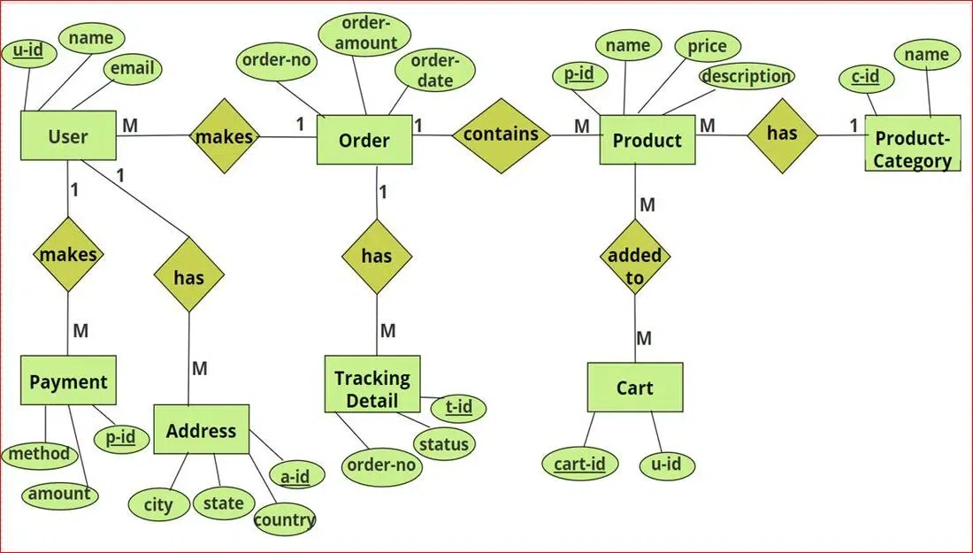
E-r Diagram

Slide 10
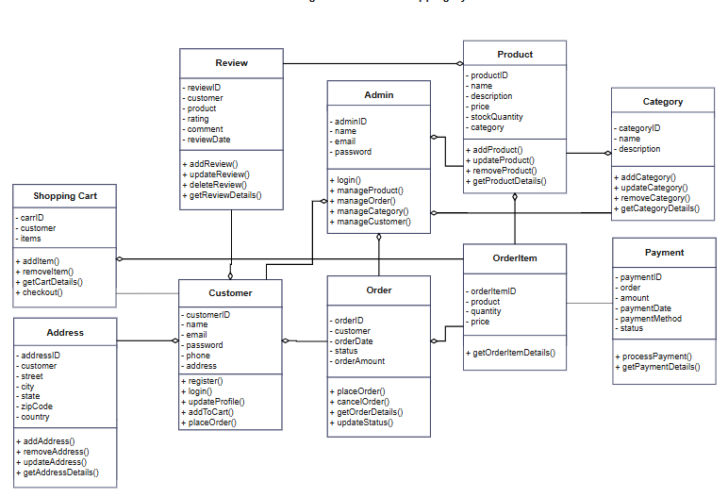
Class diagram

Slide 11
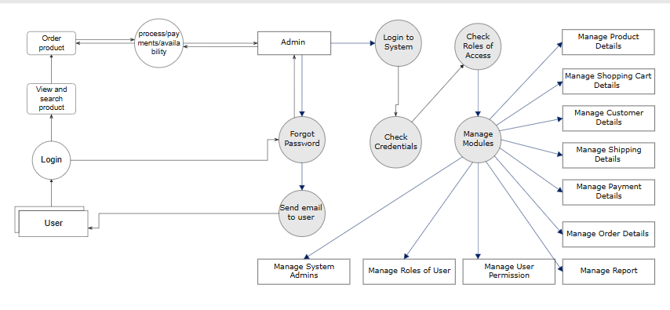
Data flow diagram(DFD)

Slide 12
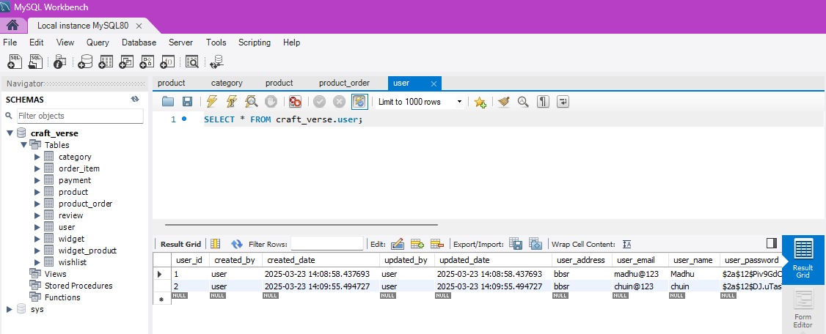
User table

Slide 13
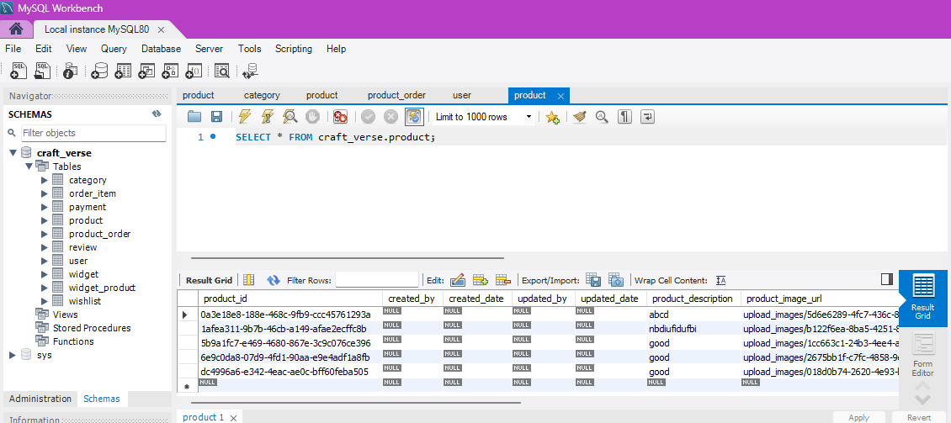
Product table

Slide 14
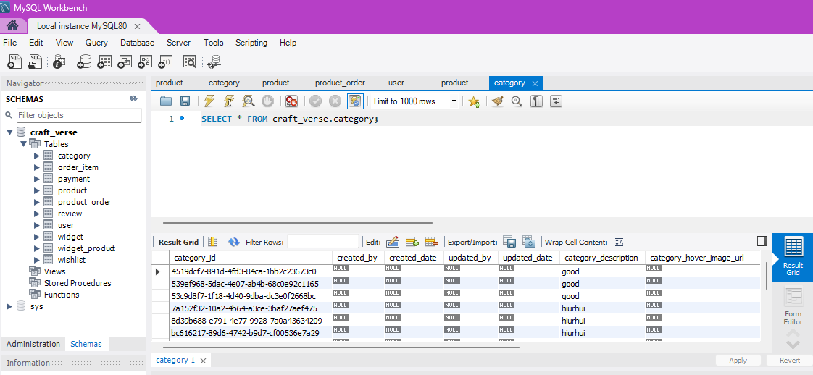
Category table

Slide 15
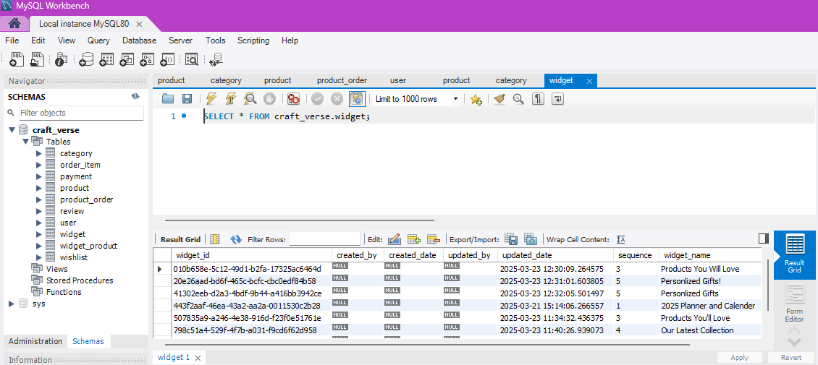
Widget table

Slide 16
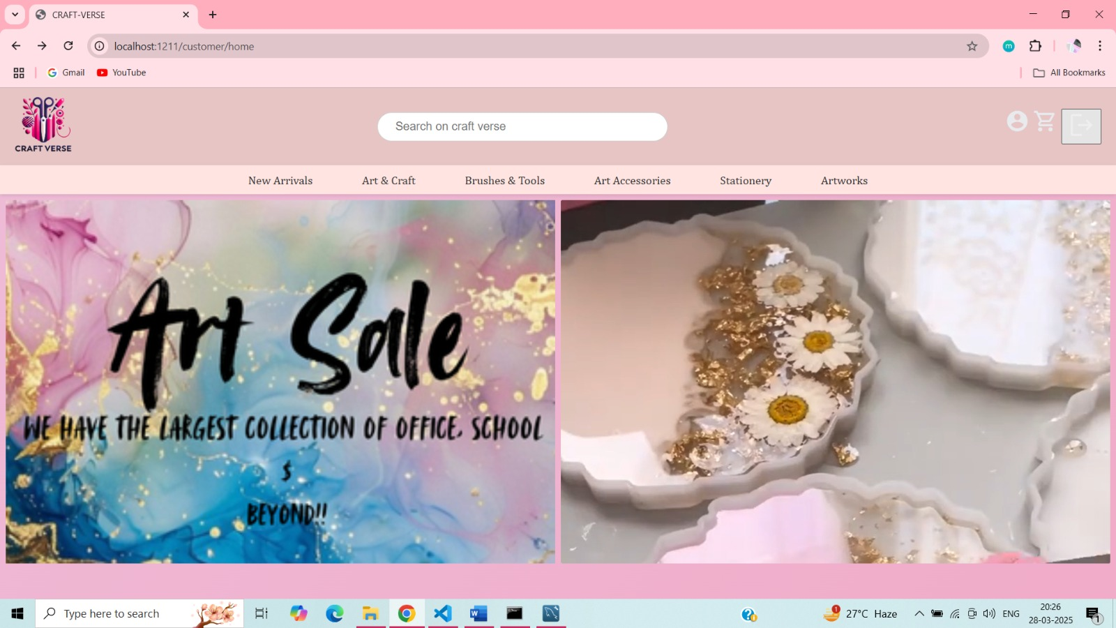
Landing page

Slide 17
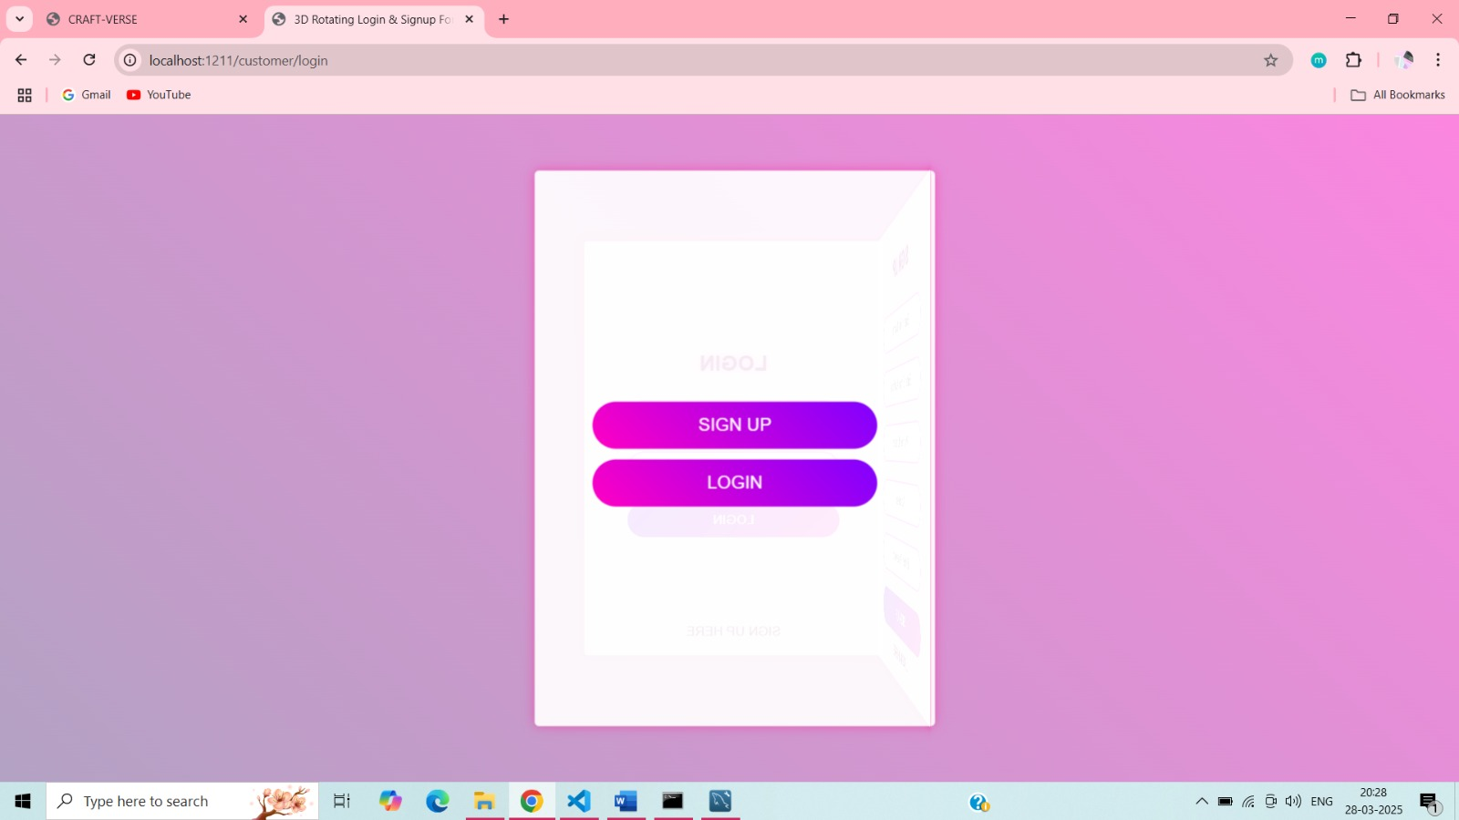
log in page

Slide 18
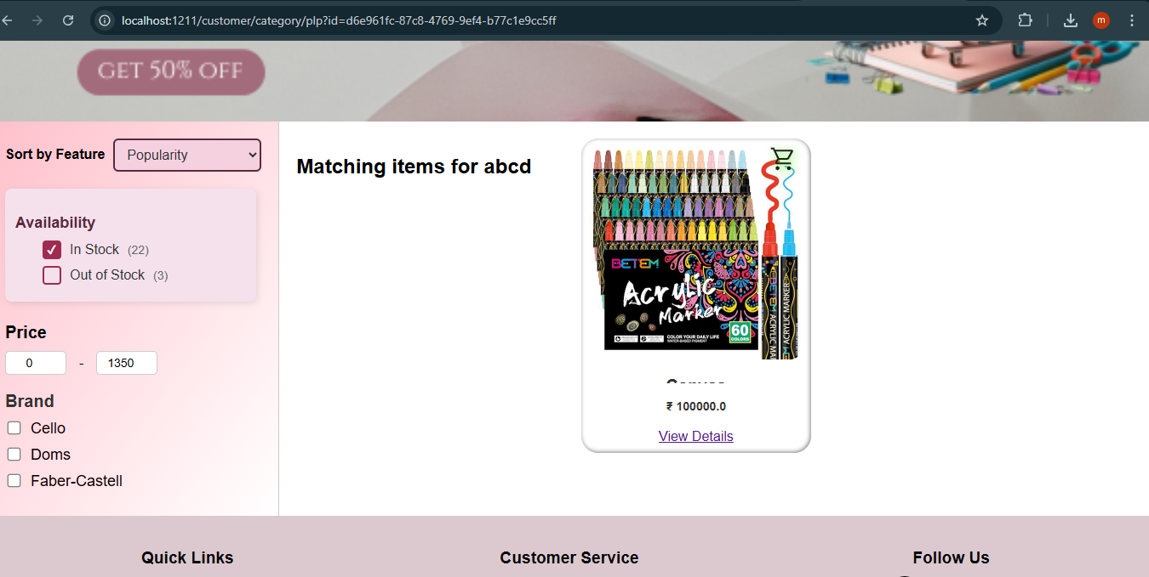
Product Listing Page(Plp)

Slide 19
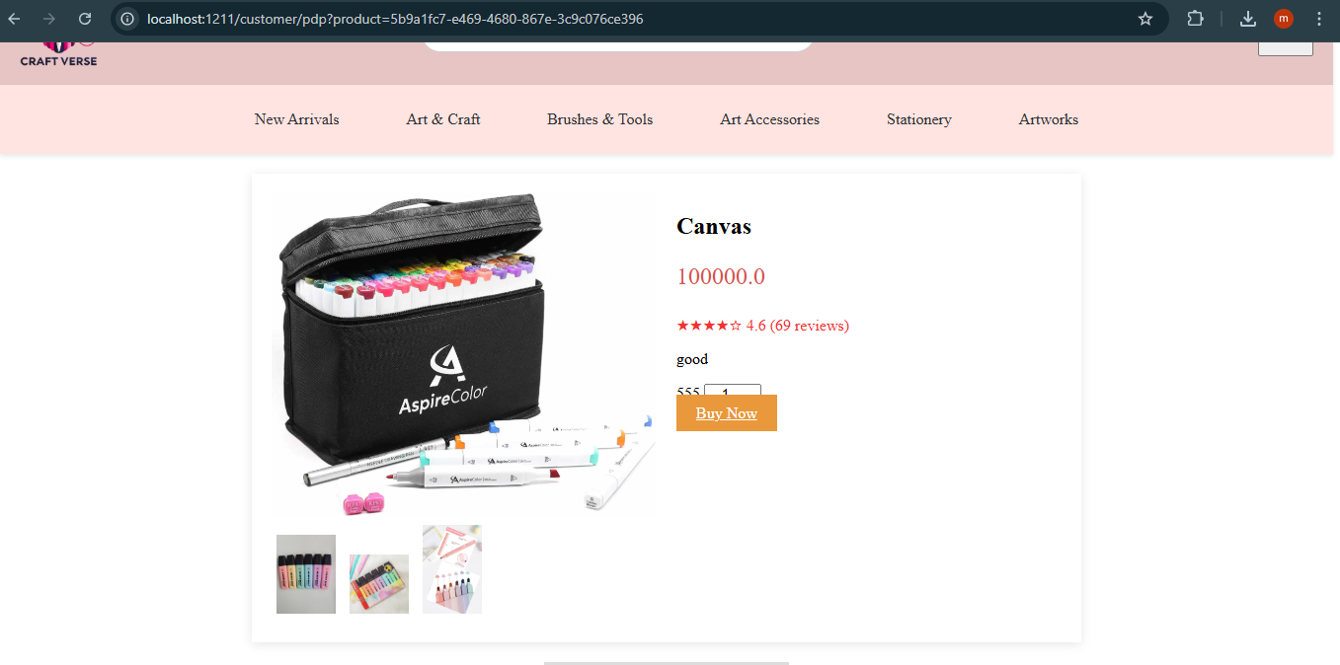
Product Detail Page (pdp)

Slide 20
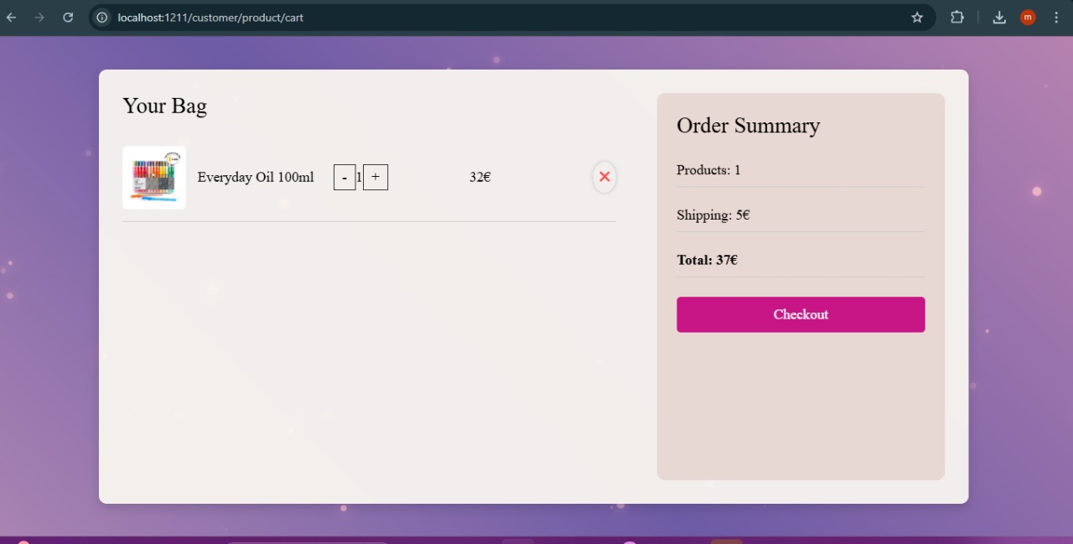
Cart page

Slide 21
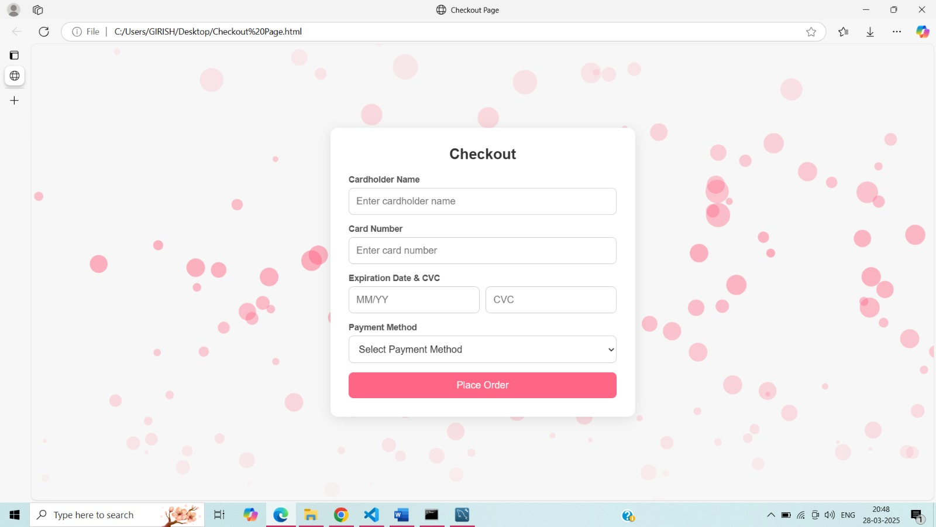
Checkout page

Slide 22
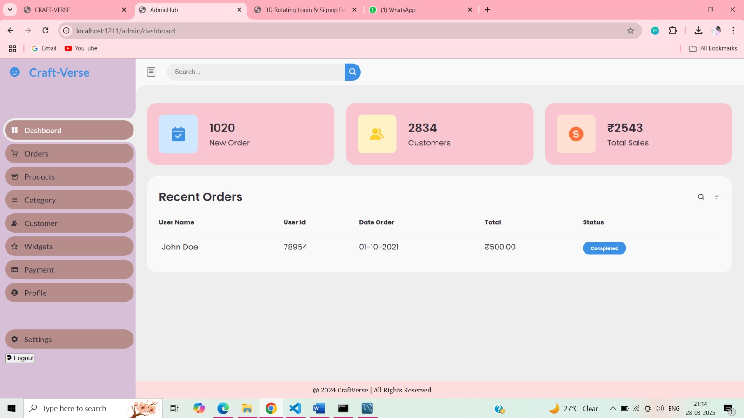
Admin dashboard

Slide 23
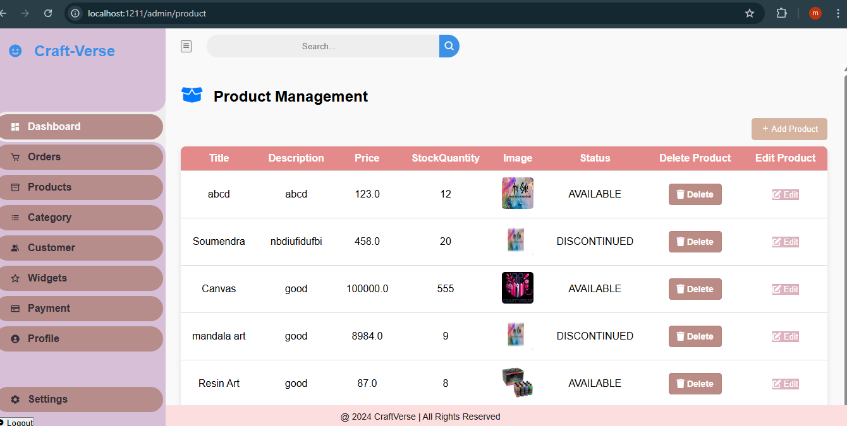
Product page

Slide 24
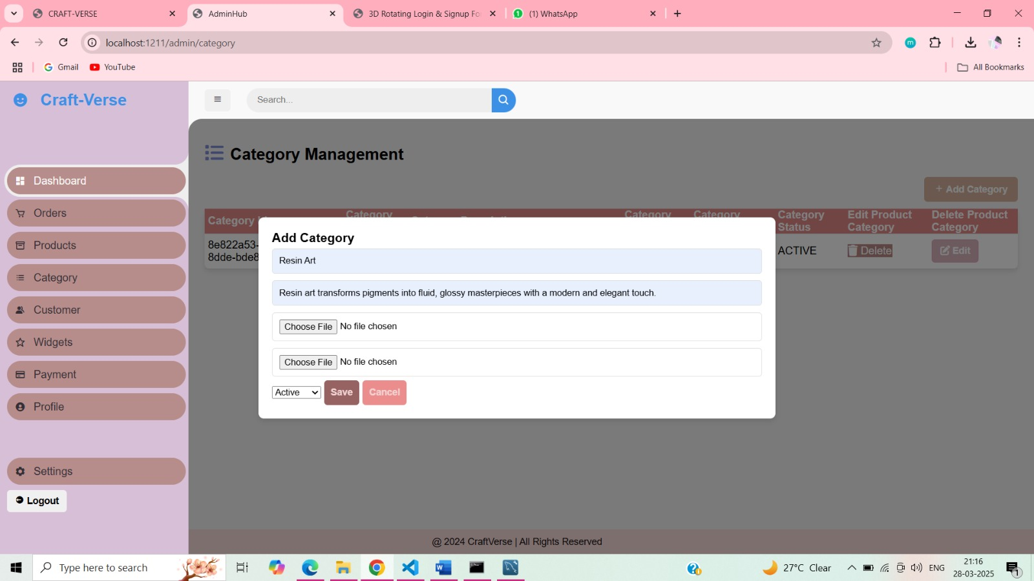

Slide 25
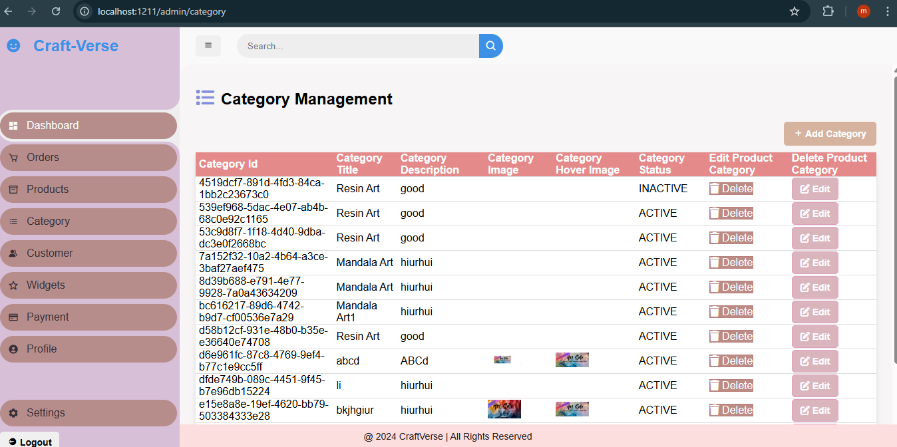
Category page

Slide 26
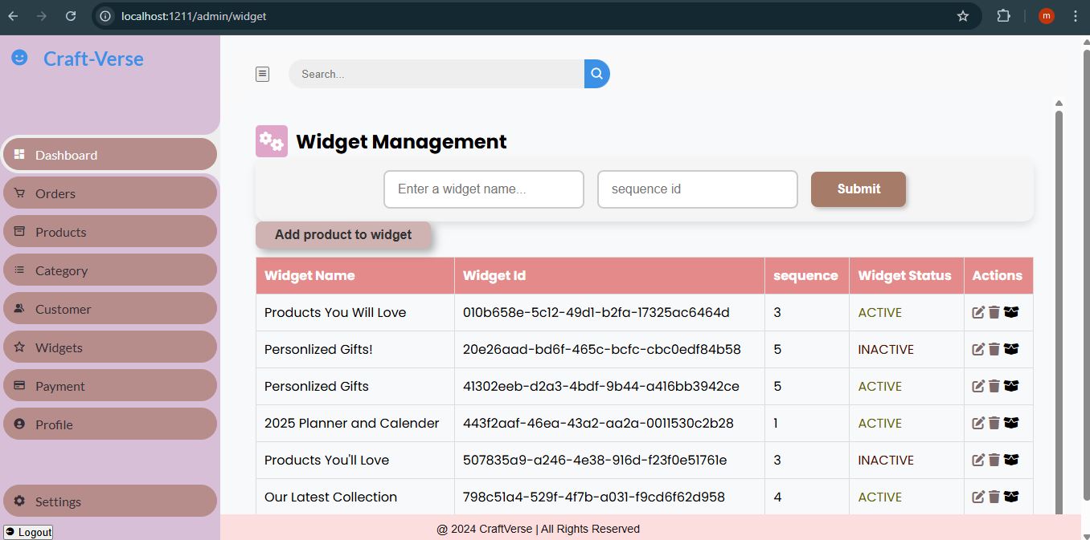
Widget page

Slide 27
Benefits
Craft Verse offers numerous advantages for both artisans and customers, creating a seamless online marketplace for handmade products. By integrating e-commerce with a thriving creative community, the platform enhances opportunities for sellers while providing unique and high-quality products for buyers.
🔹 Benefits for Artisans & Sellers
Global Market Access
Cost-Effective Business Model
Brand Growth & Visibility
Direct Customer Engagement
Secure & Efficient Transactions

Slide 28
Benefits for Customers
Exclusive Handmade
Convenience & Accessibility
Customization & Personalization
Supporting Independent Creators
Business & Market Advantages
Scalability & Business Growth
Data-Driven Insights
Sustainability & Eco-Friendliness

Slide 29
Spring Security
🔹 Key Security Features Implemented
1.User Authentication & Authorization
Spring Security Authentication
Role-Based Access Control (RBAC)
JWT (JSON Web Token) Authentication
2. Password Protection & Encryption
BCrypt Password Hashing
Password Reset & Account Recovery

Slide 30
3.API & Data Security
CORS (Cross-Origin Resource Sharing) Protection.
CSRF (Cross-Site Request Forgery) Protection.
Input Validation & SQL Injection Prevention.
4.Secure Payment Transactions
Integration with Secure Payment Gateways
Fraud Prevention Mechanisms
5. Server & Network Security
HTTPS with SSL/TLS Encryption
DDoS Protection & Firewalls
Regular Security Updates & Monitoring

Slide 31
Future Enhancements
🔹 User Experience & Interface Enhancements
Mobile Application Development
AI-Powered Product Recommendations
Augmented Reality (AR) Previews
Multi-Language & Currency Support
🔹 Marketplace & Seller Features
🔹 Security & Performance Upgrades
🔹 Community & Engagement Features

Slide 32
challenges
🔹 Technical Challenges
Scalability & Performance Optimization Database Management & Optimization (MySQL) Security Threats & Cyber Risks (SQL Injection, DDoS, Unauthorized Access) Seamless Payment Integration Cross-Browser & Mobile Compatibility
🔹 Business & Market Challenges
Attracting & Retaining Sellers & Buyers Pricing & Commission Structure Logistics & Shipping Management Customer Trust & Quality Assurance

Slide 33
🔹 Community & Engagement Challenges
Building an Active Creative Community
Handling Customer Support & Disputes
Educating Users on Sustainable Crafting
🔹 Future Growth & Innovation Challenges
Adopting New Technologies (AI, AR/VR Blockchain)
Expanding to Global Markets (Multi-Currency, Localization, Shipping)
Maintaining a Competitive Edge

Slide 34
User roles
🔹 1. Admin (Platform Manager)
Manages users, sellers, and product listings.
Monitors transactions and handles disputes.
Approves or removes products and content.
Implements security policies and platform updates.
🔹 2. Customer (Buyer/User)
Browses and purchases handmade products.
Leaves reviews and ratings for sellers.
Tracks orders and manages refunds/returns.
Engages with the community (forums, discussions).

Slide 35
conclusion
Craft Verse is a dynamic platform that bridges the gap between traditional craftsmanship and modern e-commerce, empowering artisans to showcase and sell their handmade creations. By fostering a creative community, offering customization features, and ensuring a secure shopping experience, Craft Verse enhances both artisan visibility and customer satisfaction.
With a focus on authenticity, innovation, and sustainability, the platform not only supports independent creators but also brings unique, high-quality handmade products to a global audience. As the demand for customized and handcrafted goods continues to rise, Craft Verse remains committed to evolving and expanding, making craftsmanship more accessible, valued, and celebrated in the digital age.
Customization in the craft industry is revolutionizing how customers interact with handmade products. Craft Verse embraces this trend by providing a platform where artisans can offer personalized, made-to-order creations that reflect individual tastes and preferences.

Slide 36
references
1. Spring Boot Documentation – Official guide for backend development and REST API implementation.🔗 https://spring.io/projects/spring-boot
2. Java SE Documentation – Core Java programming reference for backend development.🔗 https://docs.oracle.com/javase/
3. MySQL Documentation – Database management and structured query language (SQL) reference.🔗 https://dev.mysql.com/doc/
4. Thymeleaf Documentation – Template engine used for dynamic UI rendering in Spring Boot applications.🔗 https://www.thymeleaf.org/documentation.html
5. MDN Web Docs – HTML, CSS, and JavaScript references for frontend development. 🔗 https://developer.mozilla.org/en-US/• GeeksforGeeks – Guides on Java, Spring Boot, and MySQL integration.🔗 https://www.geeksforgeeks.org/• GitHub Documentation – Version control and repository management for the Craft Verse project.🔗 https://docs.github.com/en

Slide 37
Thank you

